Slide 1





Lesson 3:Catch the Bus

Slide 2
Slide

Slide 3
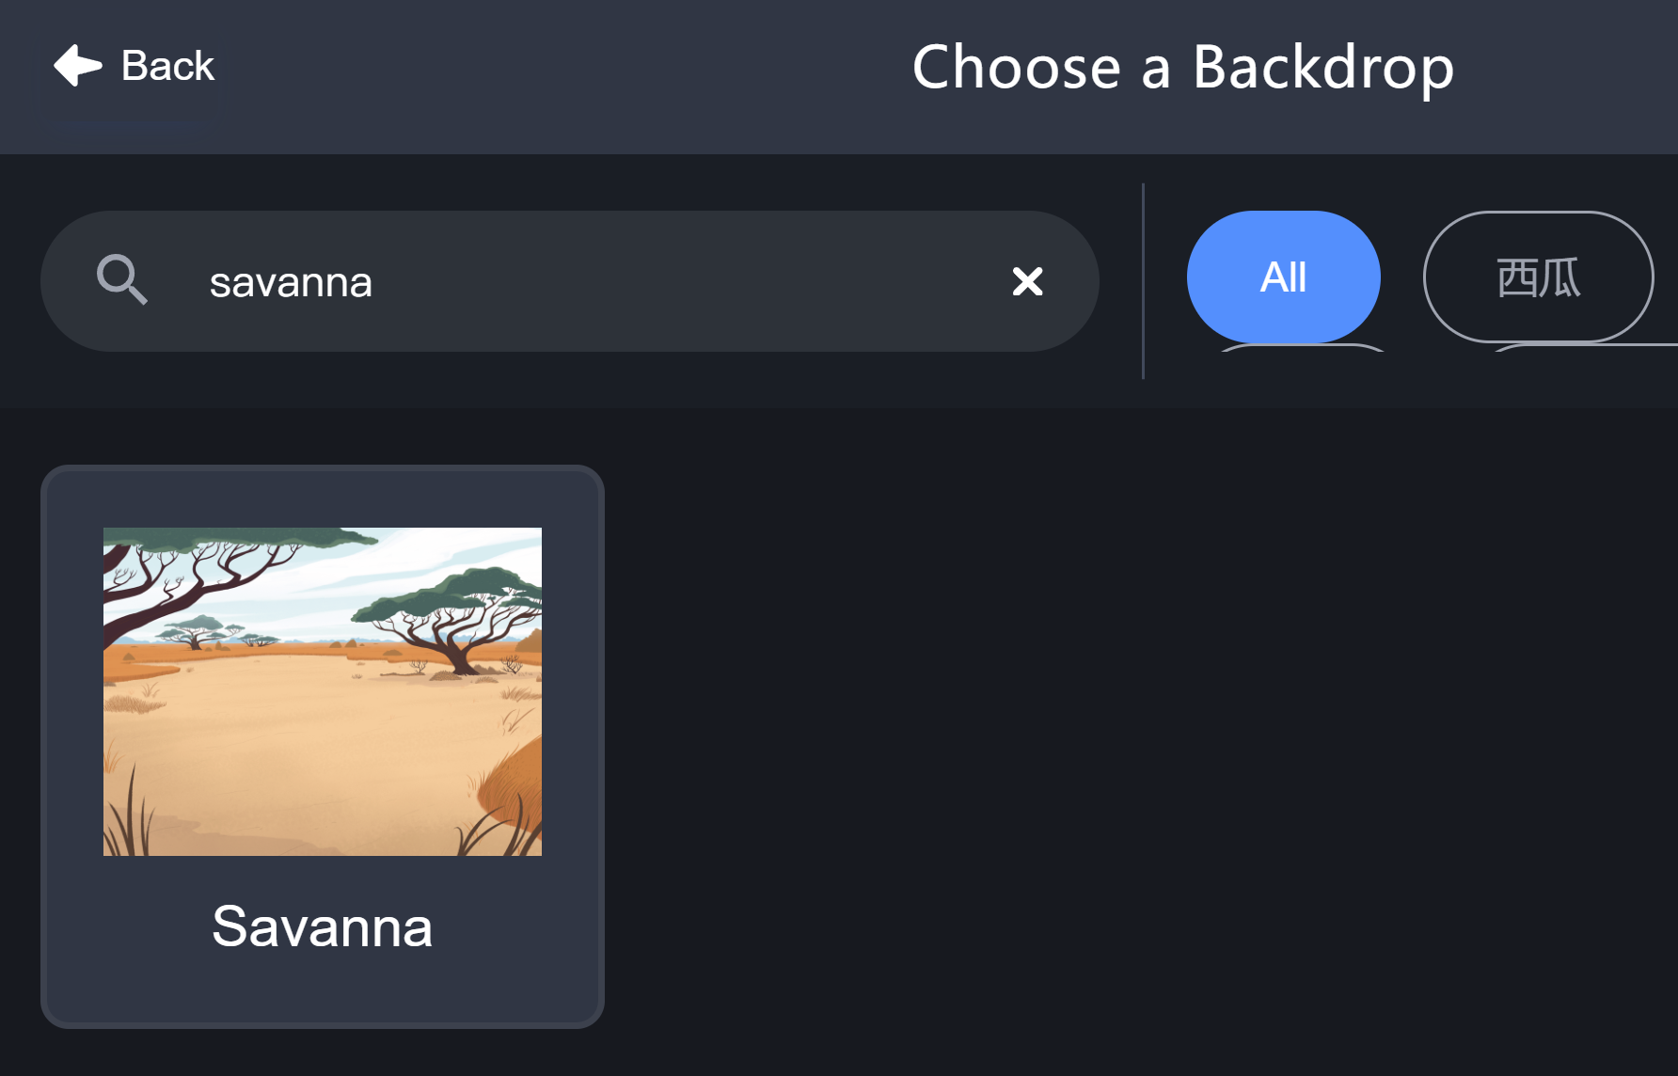
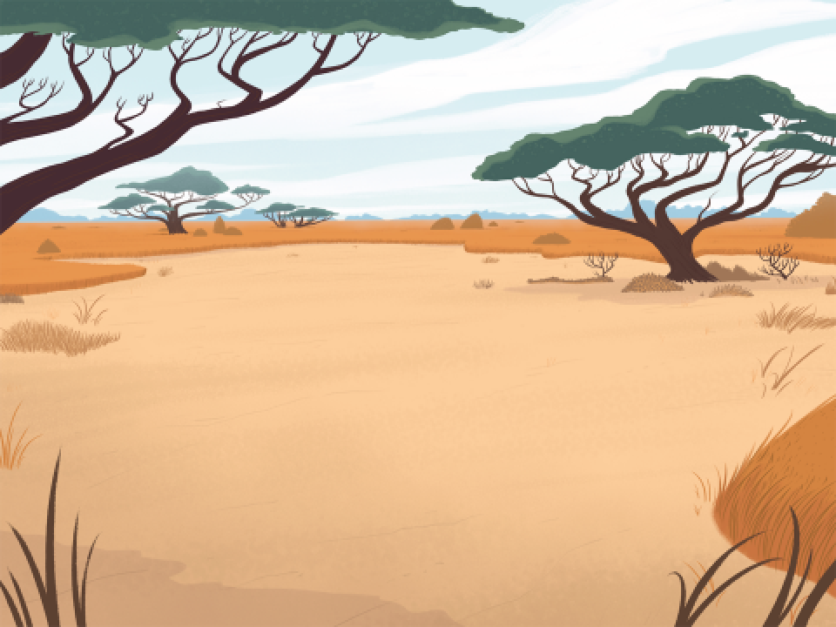
Backdrop - Savanna

Slide 4

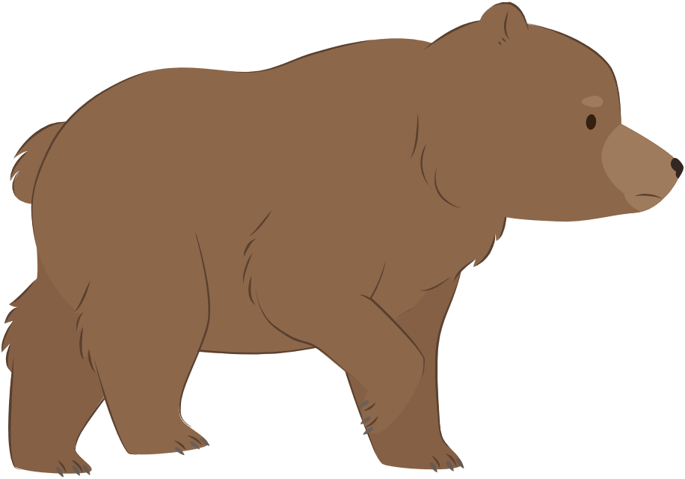

Animal Sprites
Bear
Parrot
Hedgehog

Slide 5
Change Sprite Size
size: 50
size: 100
size: 200

Slide 6
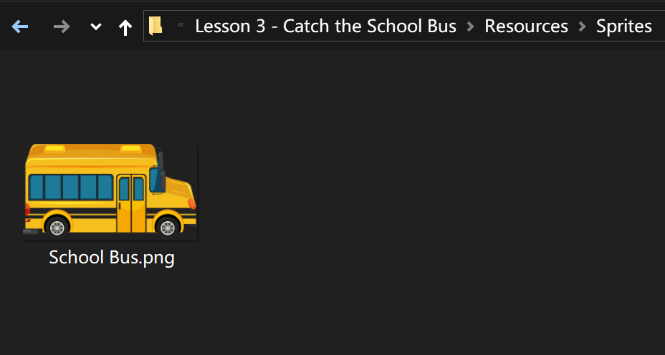

School Bus

Slide 7
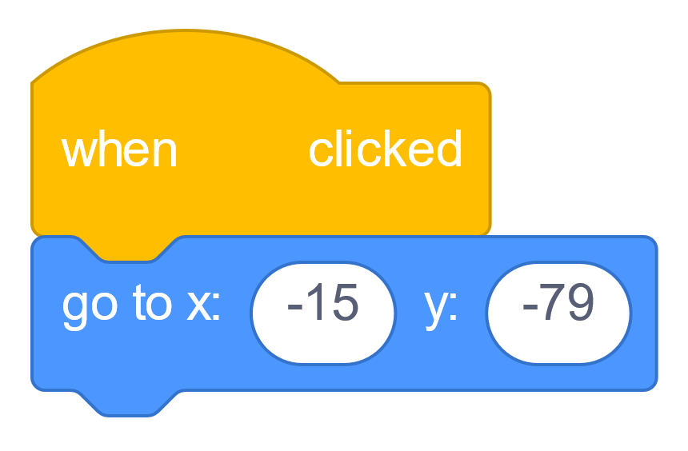
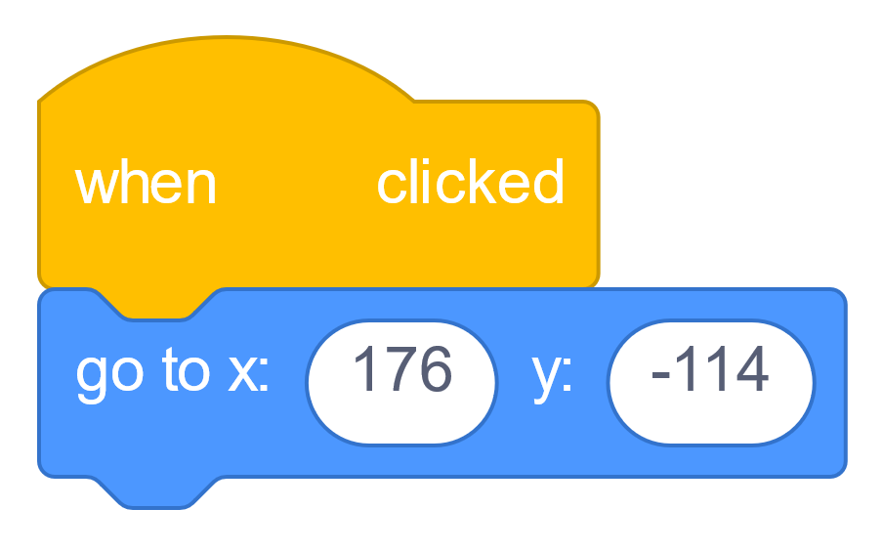

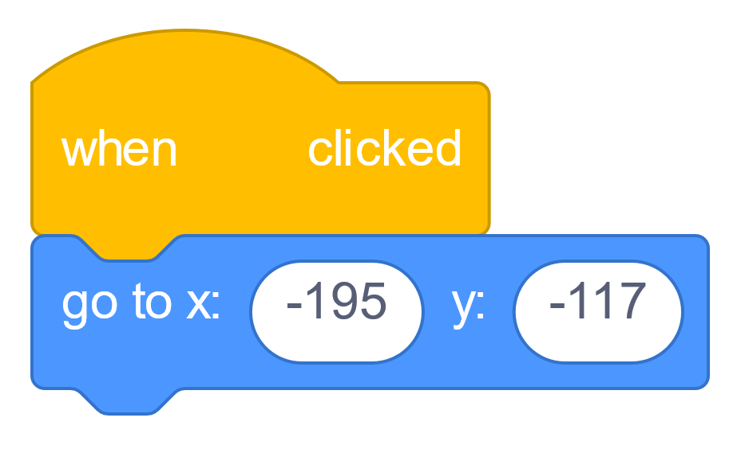
Get in Place!

Slide 8
Bear Walks

Slide 9
Not Facing the Bus!

Slide 10
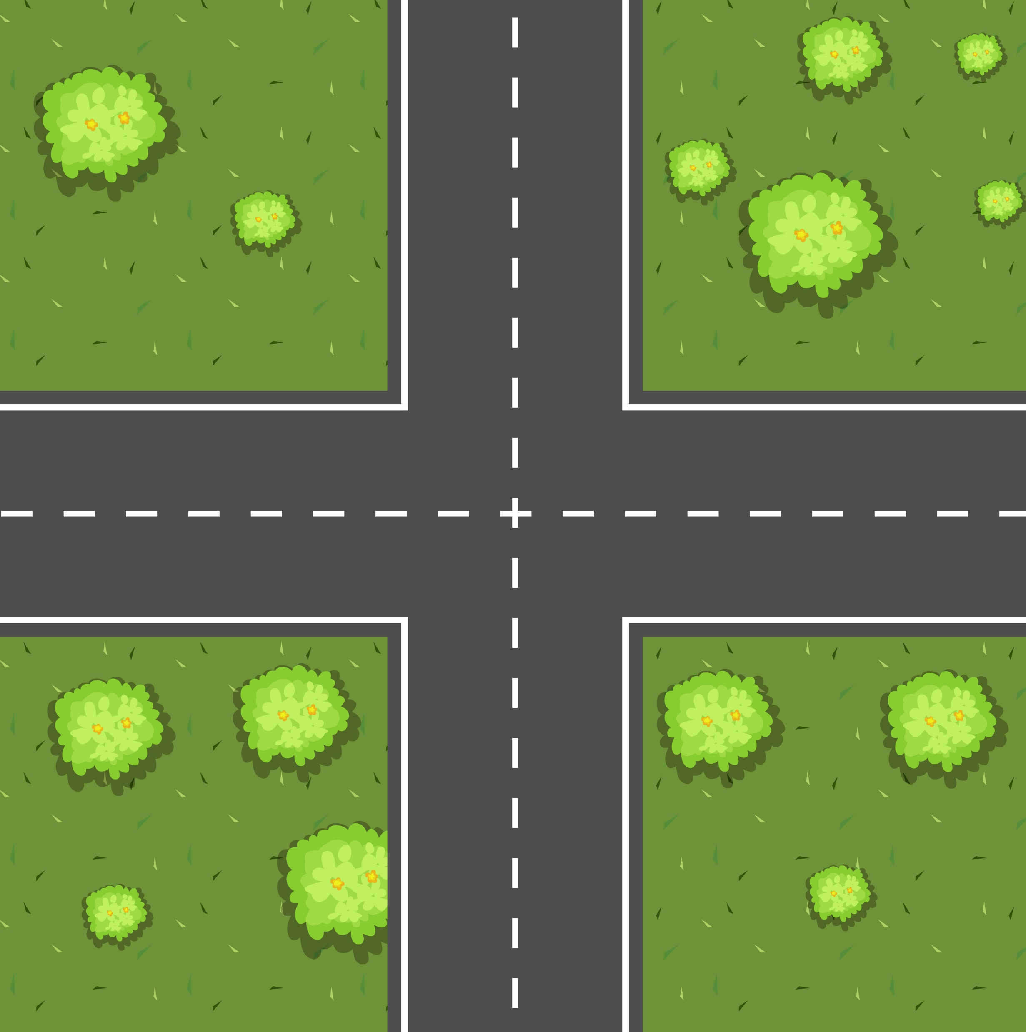

Directions
North
West
East
South

Slide 11
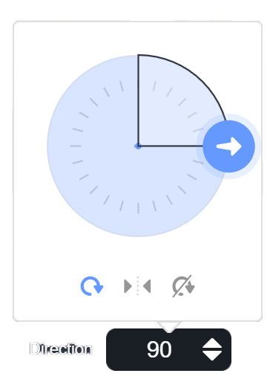
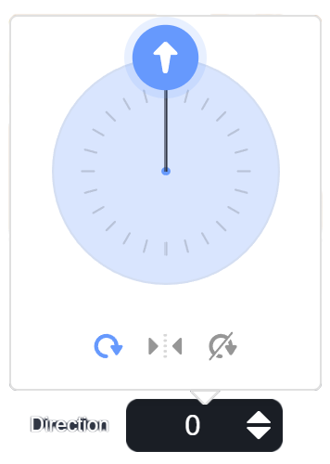
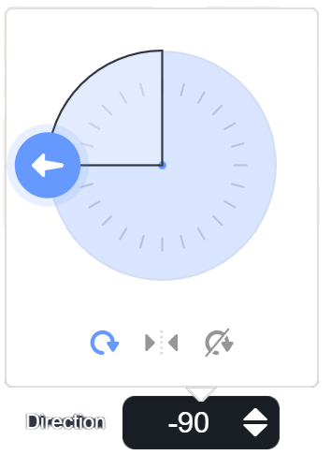
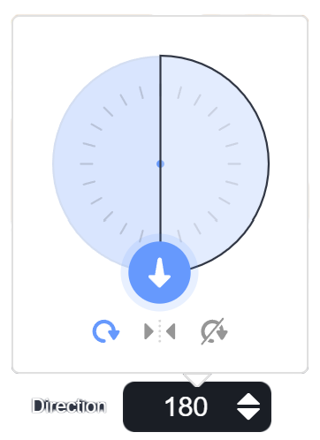
Direction Clock

Slide 12
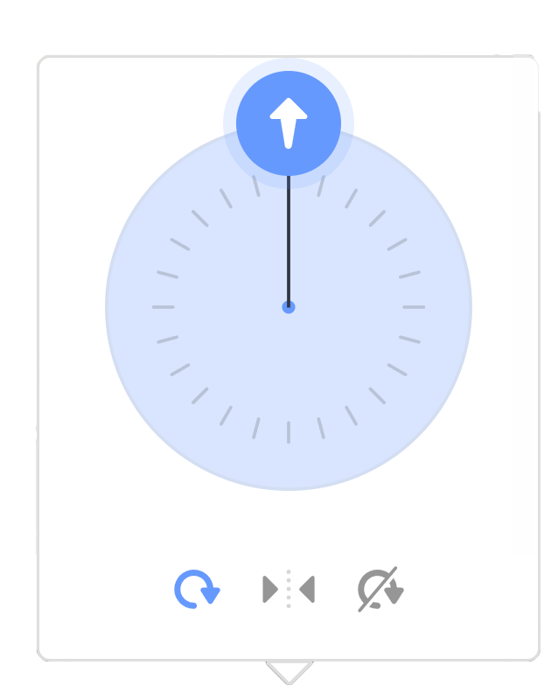

Direction Clock
-1°
0°
-179°
180°

Slide 13
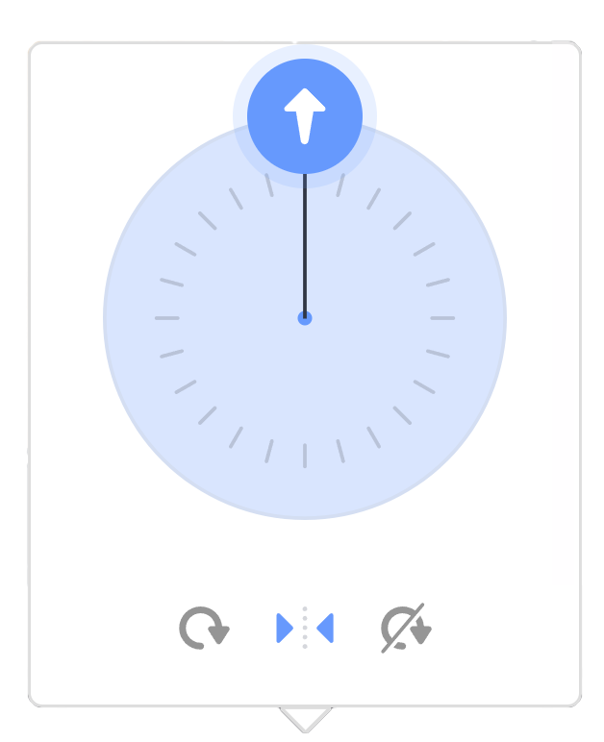
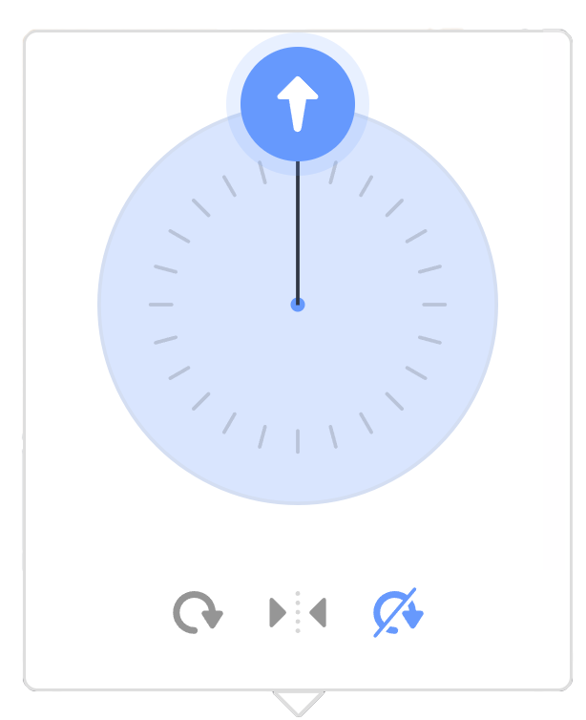
Rotation Style
All Around
Left/Right
Do not Rotate

Slide 14
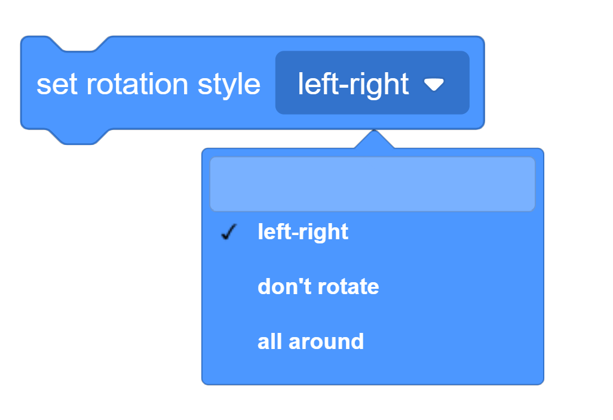
Set Rotation Style

Slide 15

Set Direction

Slide 16
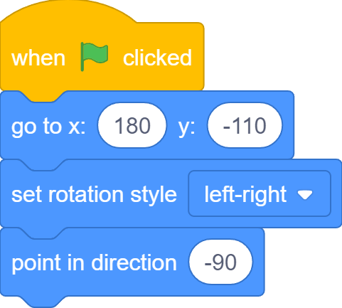
Face the Bus

Slide 17

Glide to the Bus

Slide 18
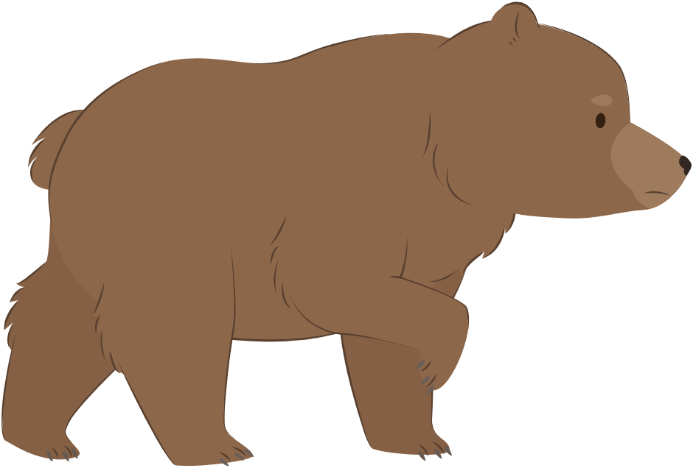
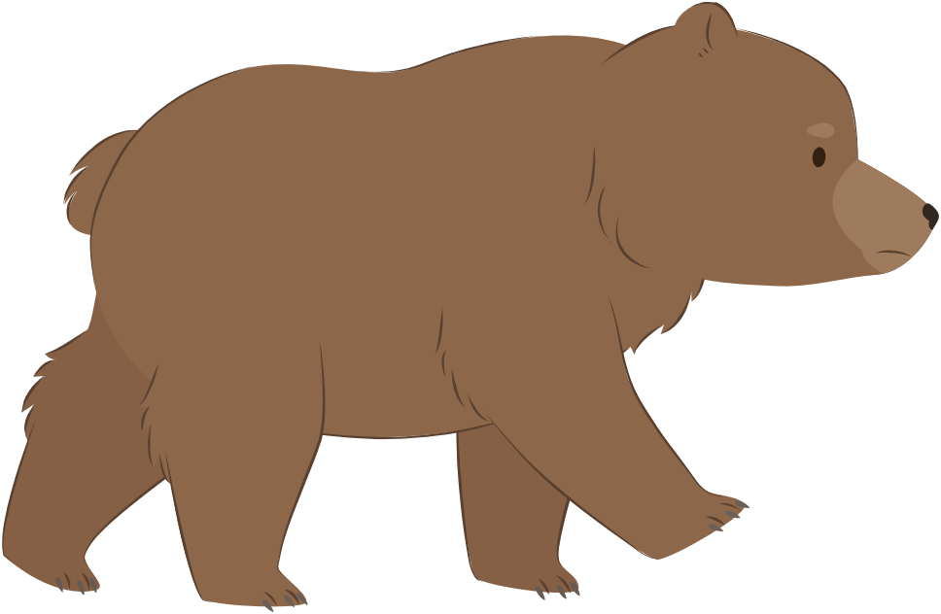
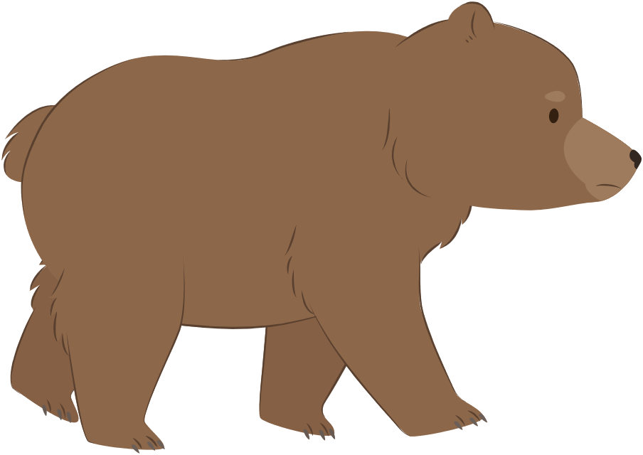
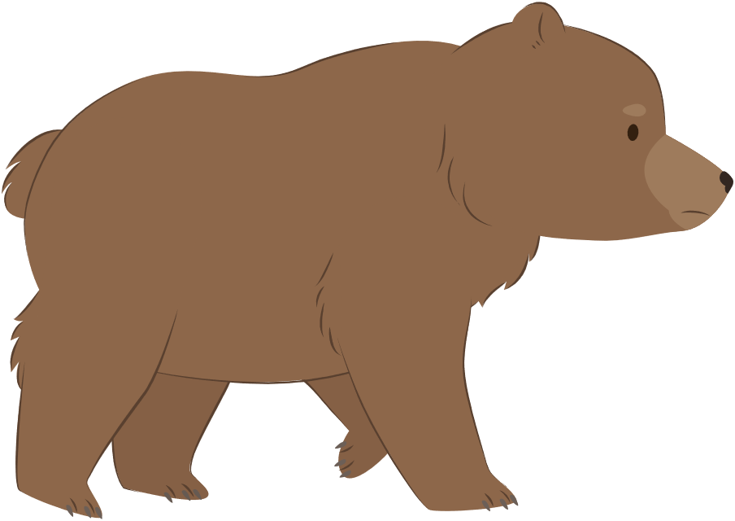
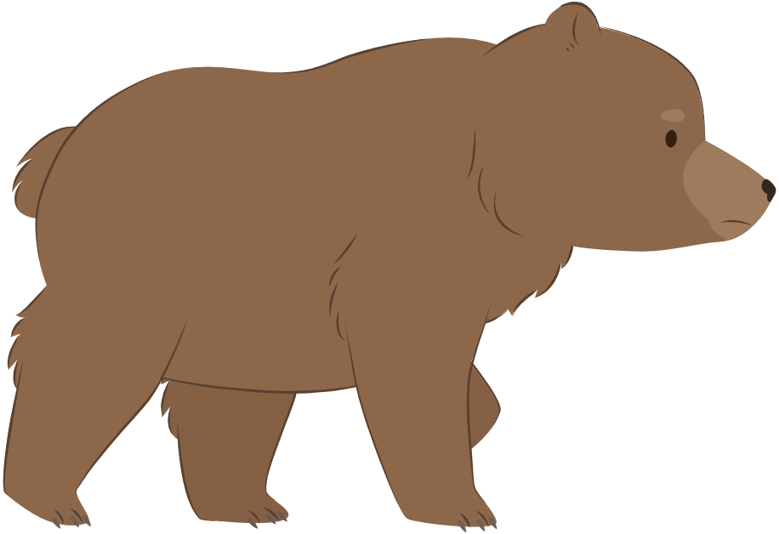
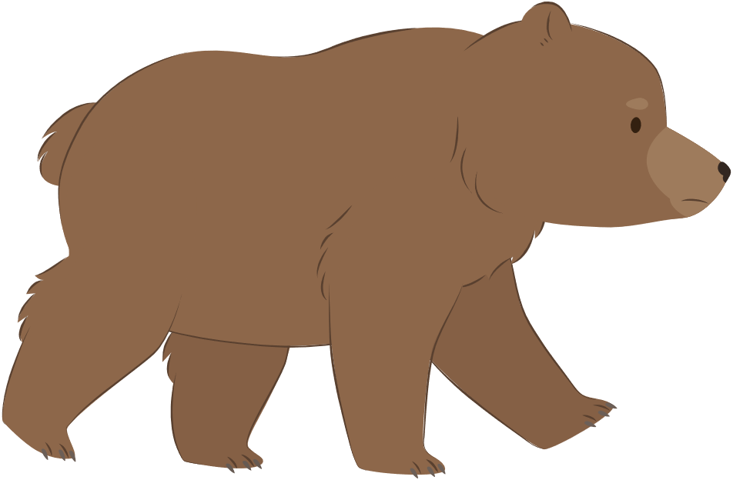
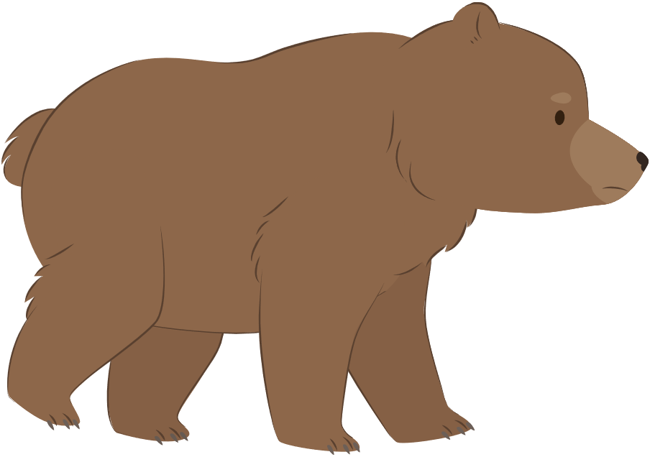
How bear Walks
bear-walk-a
bear-walk-b
bear-walk-c
bear-walk-d
bear-walk-e
bear-walk-f
bear-walk-g
bear-walk-h

Slide 19
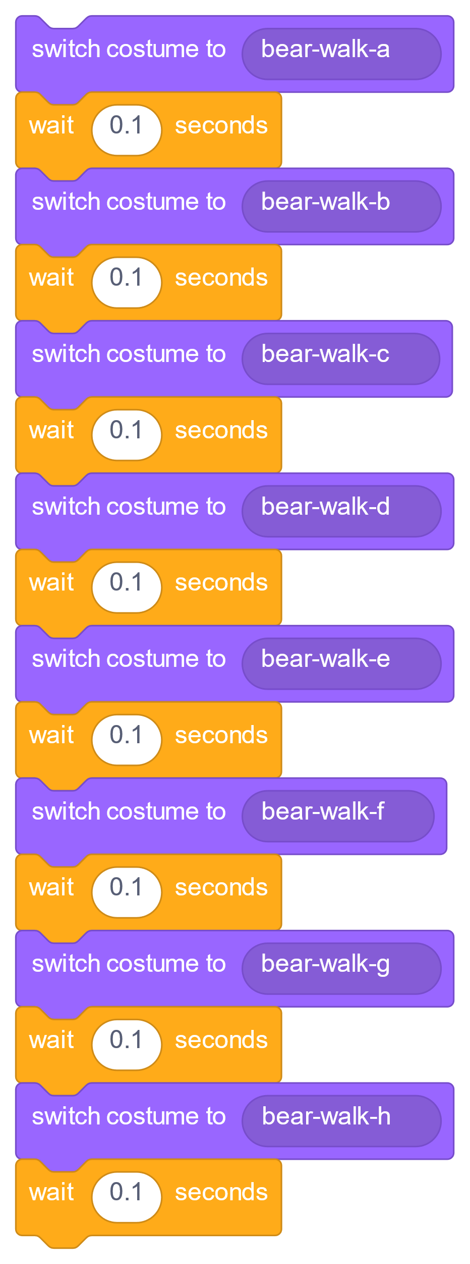
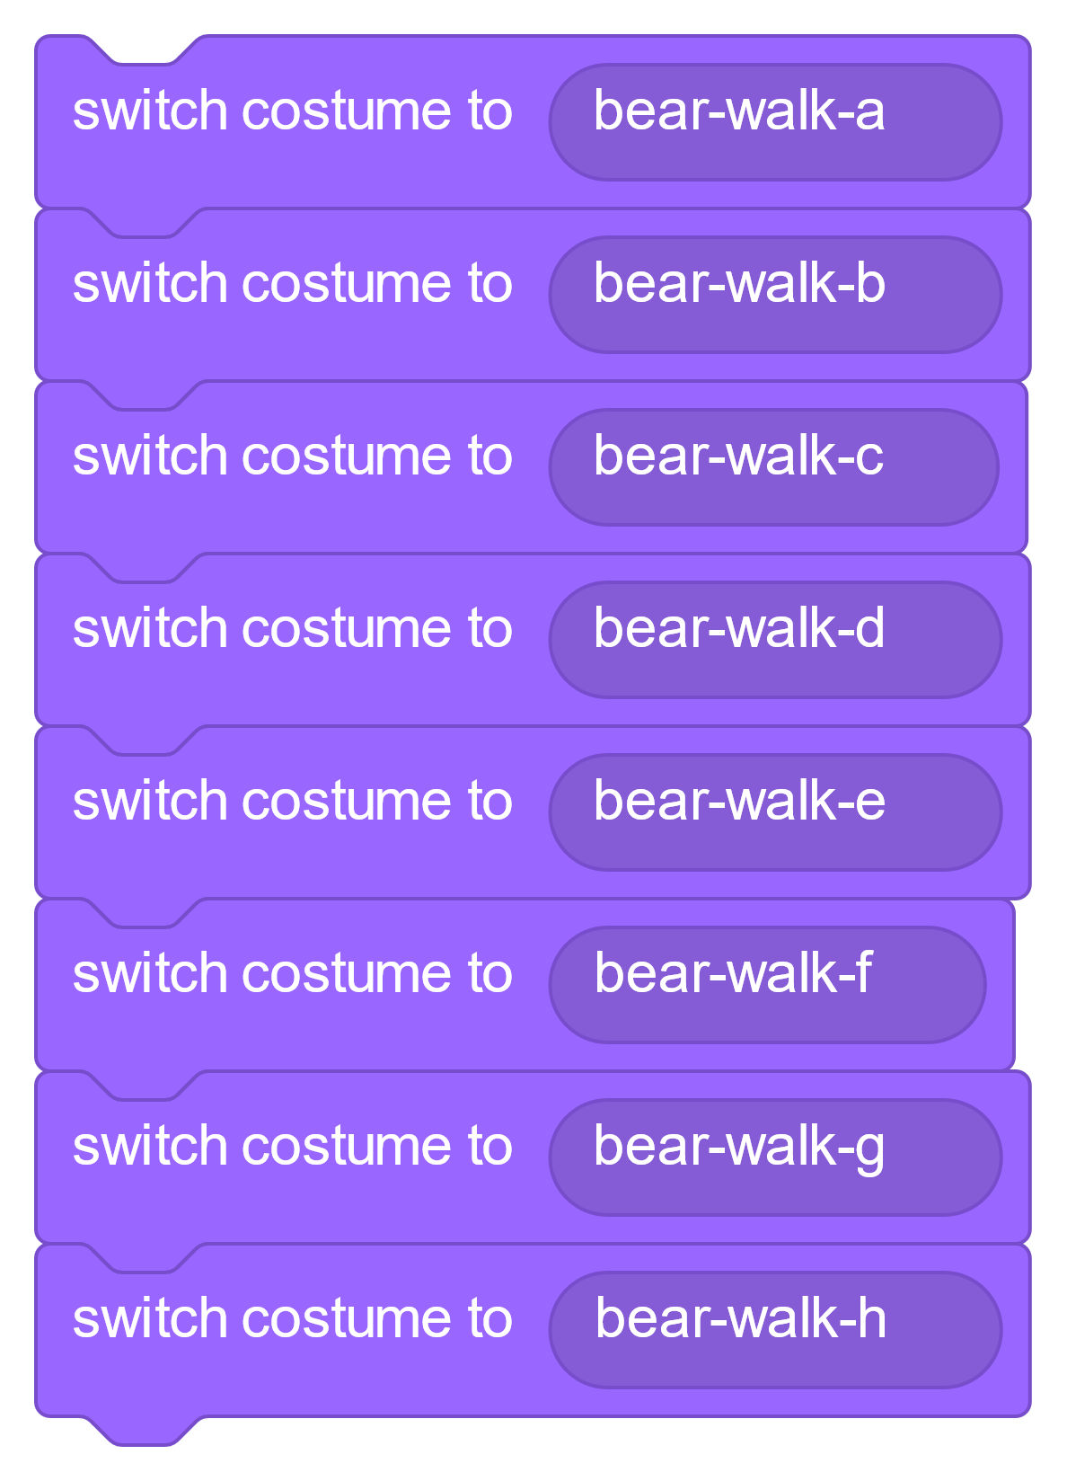
Switch Costumes

Slide 20

Next Costume
bear-walk-a
bear-walk-b
bear-walk-c
bear-walk-d
bear-walk-h
bear-walk-g
bear-walk-f
bear-walk-e

Slide 21
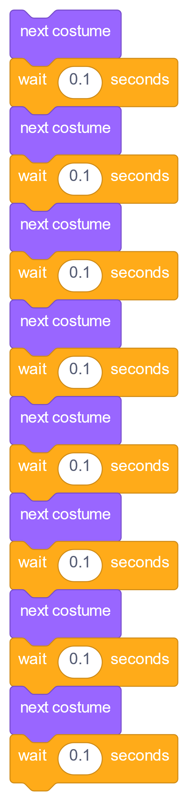
Switch Costumes

Slide 22
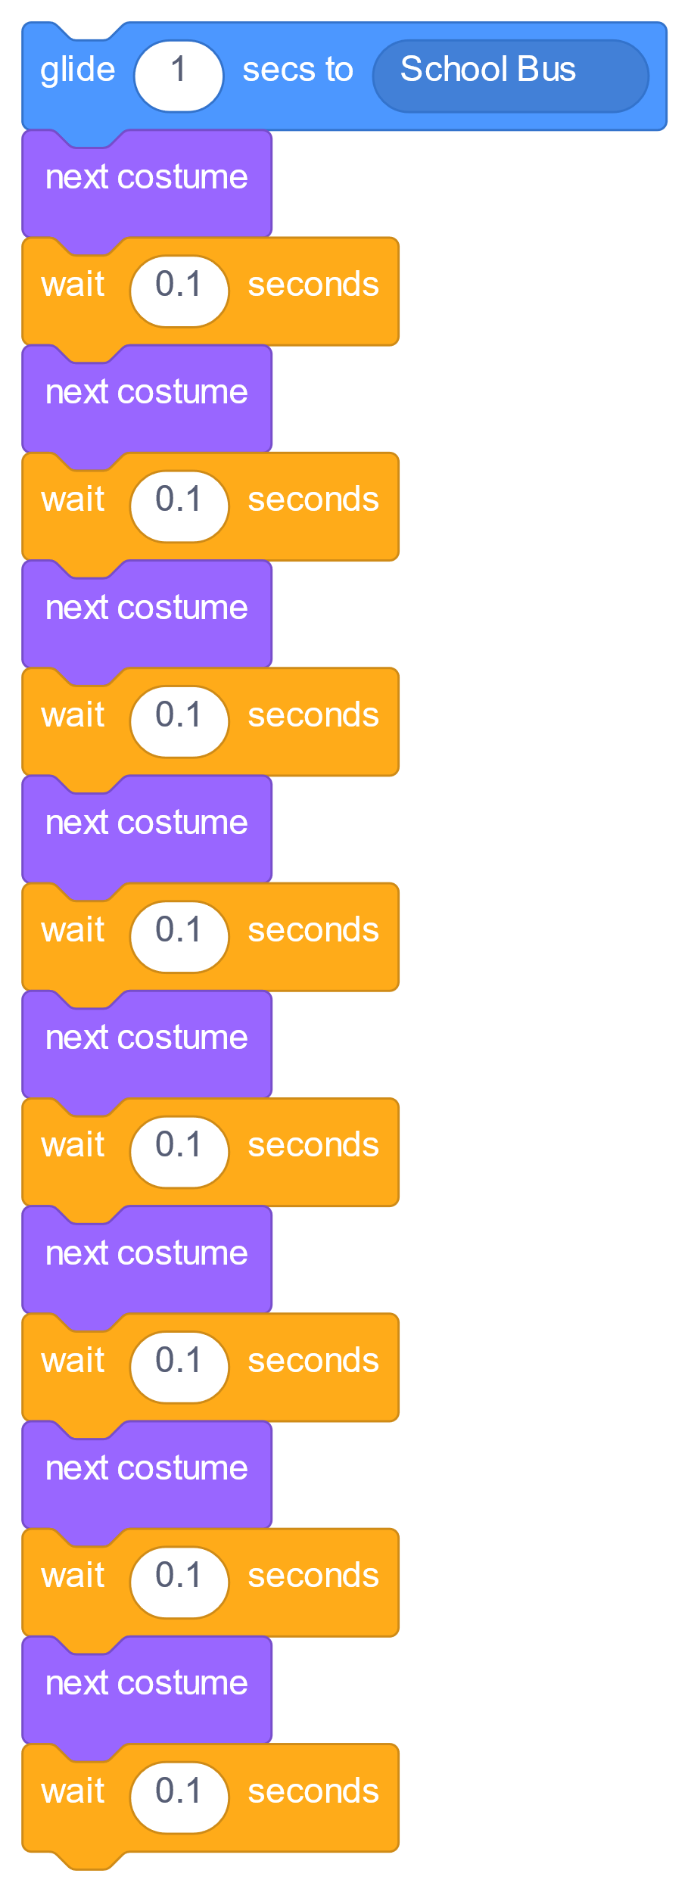
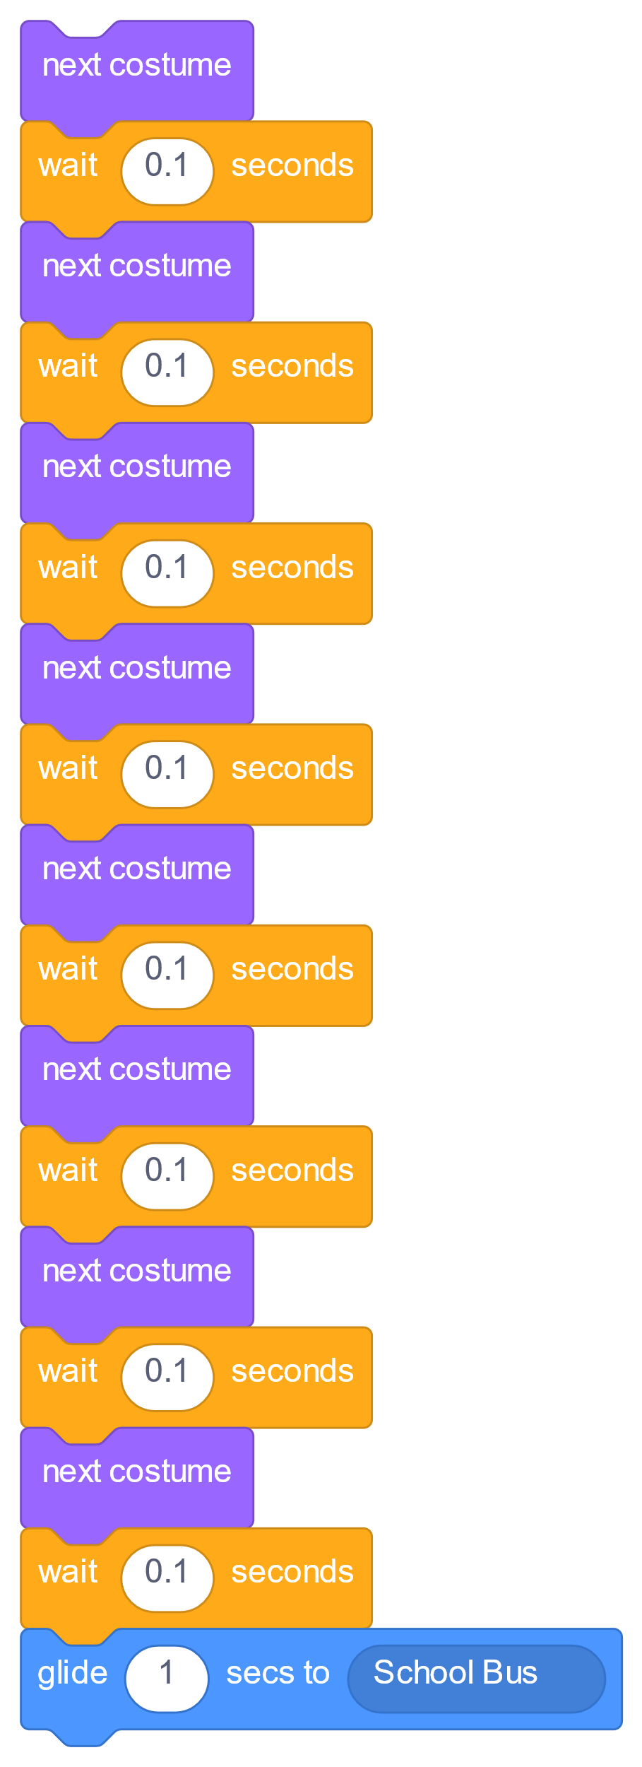
When to Glide?
Before or after switching costumes?

Slide 23
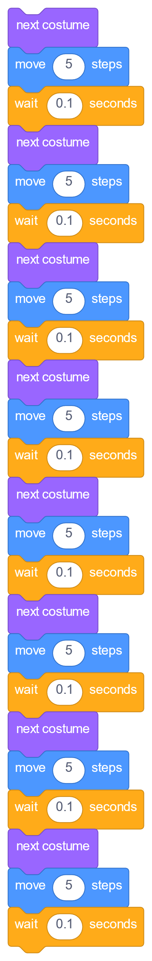
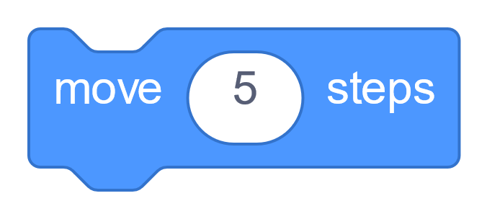
Move While Switching Costumes

Slide 24
Far Enough?
8 moves
Not at the bus yet!!!

Slide 25
Far Enough?
16 moves
Better, still not quite!!!

Slide 26
Add Even More Moves?
No! Long script with repetitive code is bad!

Slide 27



Loop

Slide 28
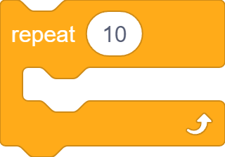

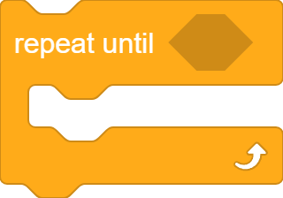
Loops in Scratch

Slide 29
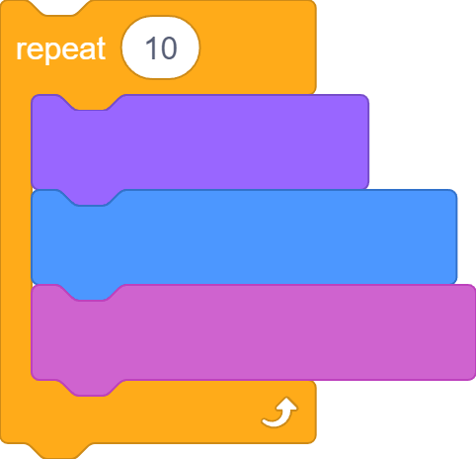
Repeat Block
Number of iterations
Code blocks to iterate

Slide 30
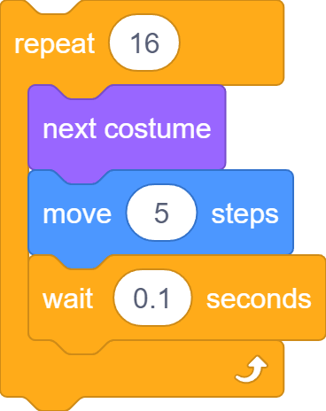
Repeat Block

Slide 31
Repeat Block

Slide 32




Show and Hide

Slide 33
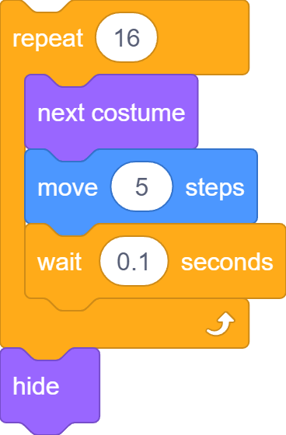
Get on the Bus

Slide 34
Problem
Bear is still hidden the next time round!

Slide 35
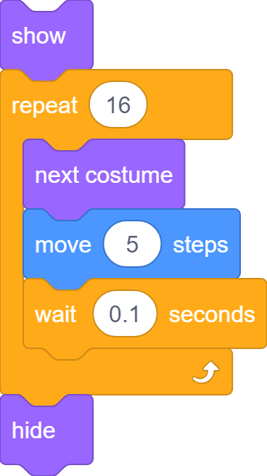
Show it!

Slide 36
Complete Code

Slide 37
Parrot Flies

Slide 38
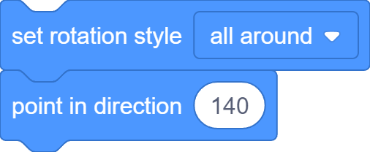
Face the Bus

Slide 39
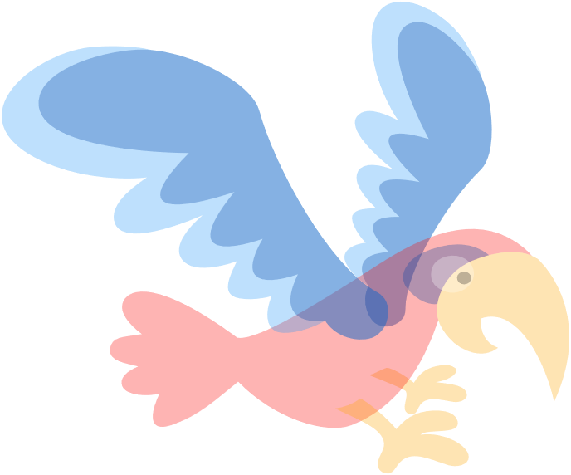
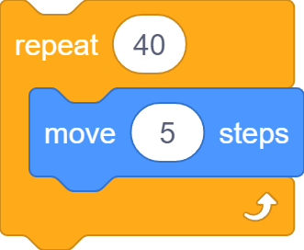
Move to the Bus

Slide 40

Two Costumes
parrot-a
parrot-b

Slide 41
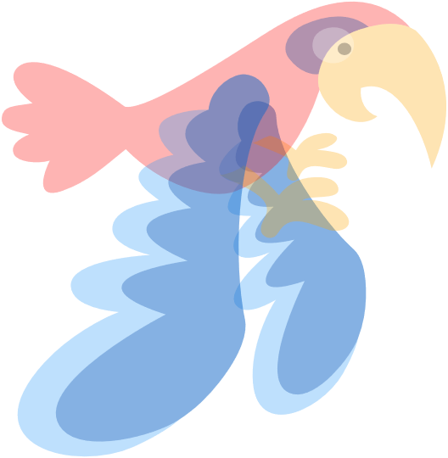

Fly to the Bus

Slide 42
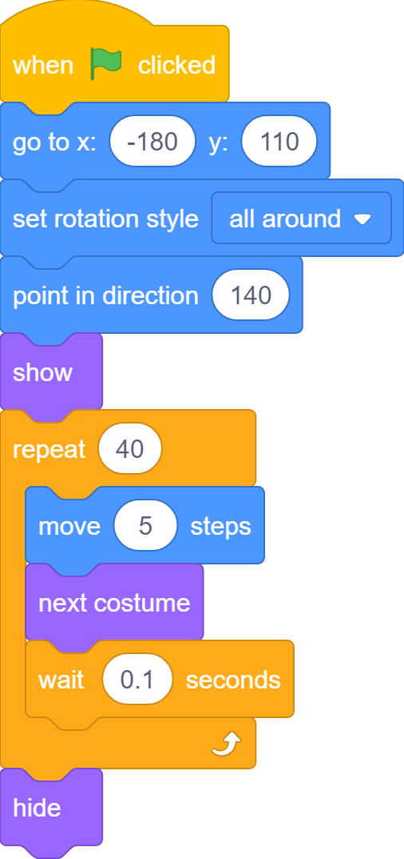
Complete Code

Slide 43

Hedgehog Rolls

Slide 44
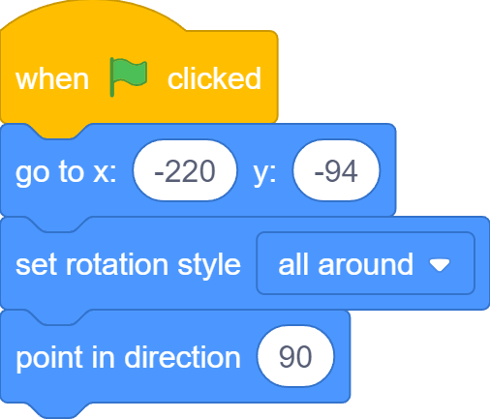
Point to the Right

Slide 45
Move to the Bus

Slide 46





Let’s Roll!

Slide 47

How Wheels Rotate
Center point

Slide 48
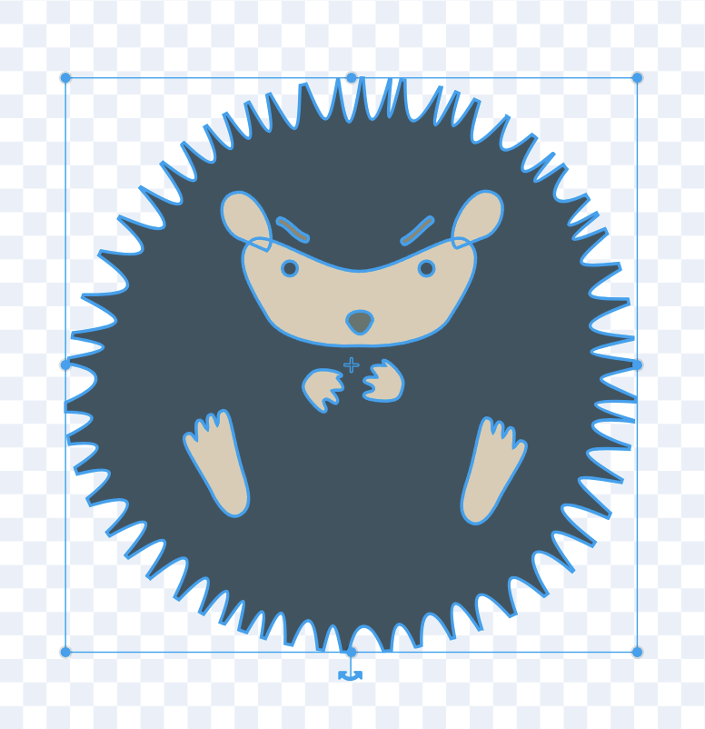
Hedgehog’s Center Point

Slide 49
Rotate Sprite

Slide 50


Rotate Sprite
Turn clockwise / Turn right
Turn counter clockwise / Turn left

Slide 51
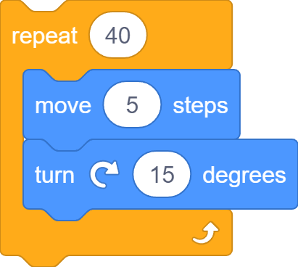
Let’s Roll!

Slide 52






Roll, Not Spin!
…

Slide 53


Change x/y Coordinates

Slide 54
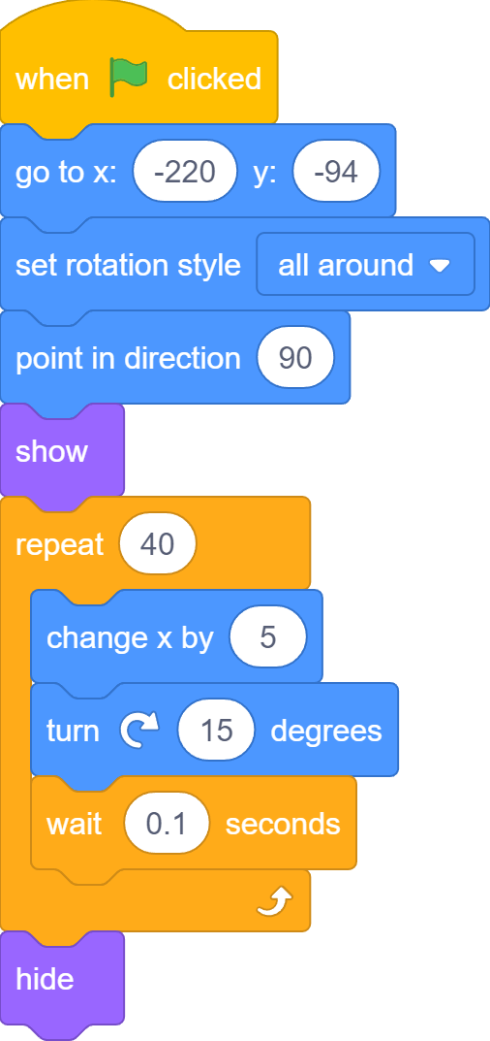
Complete Code

Slide 55
Bus Leaves
-240
0
240
x axis

Slide 56


Bus Leaves
Too fast!
Move more slowly

Slide 57
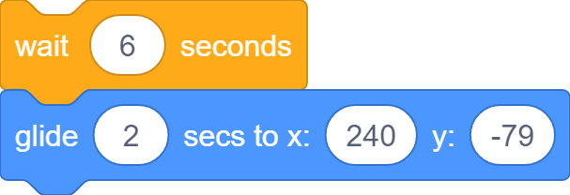
Wait Before Leave

Slide 58
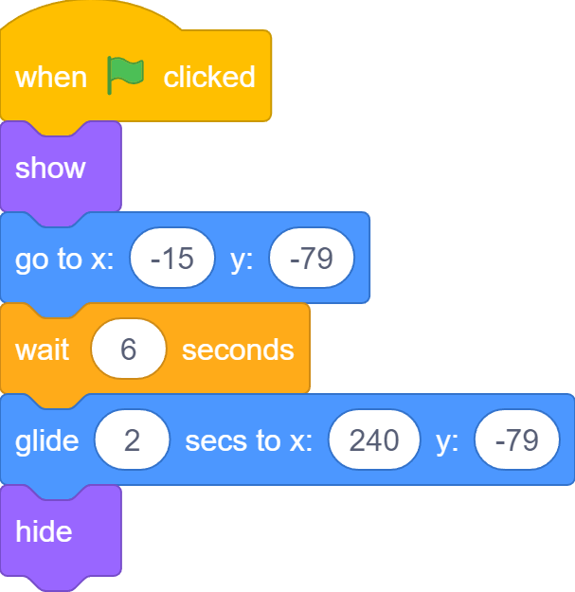
Complete Code

Slide 59
What we learnt…
What are directions and degrees…

Slide 60
What we learnt…
All Around
Left/Right
Do not Rotate
Different rotation styles…

Slide 61
What we learnt…
How to use code to change direction and rotation styles…

Slide 62


What we learnt…
How to create animation by switching costumes…

Slide 63
What we learnt…
How to make a sprite move…

Slide 64

What we learnt…
How to repeat the same thing over and over again…

Slide 65
What we learnt…
How to show and hide a sprite…

Slide 66
What we learnt…
How to turn a sprite…

Slide 67
What we learnt…
How to always move a sprite horizontally or vertically…

Slide 68
Exercises
Is there a way to change a sprite’s size using code?
Is there a way to know a sprite’s size using code?
Play with different rotation styles
Is there a way to know a sprite’s direction using code?
Is there a way to know a sprite’s costume number of name using ode?

Slide 69
Exercises
Summarize the differences between all blocks (ones we’ve learnt) that move a sprite to a different location.
Is there another way to achieve what “go to” block does (Hint: use a pair of blocks)?
Can you find more “loop” examples in real life?
What would happen if you repeat 0 times? A negative number of times?

Slide 70
Exercises
Summarize the differences between all blocks (ones we’ve learnt) that move a sprite to a different location.
Is there another way to achieve what “go to” block does (Hint: use a pair of blocks)?
Can the “move” block in the bear script be changed to some other block that we learnt today?
Is there a way to know a sprite’s x/y cooridnates using code?

Slide 71
Exercises
Can you find more “loop” examples in real life?
What would happen if you repeat 0 times? A negative number of times?
Can you make a sprite rotate like the second hand of a clock, meaning it ticks each second, and finishes one full circle after 60 seconds?
Add more sprites to catch the bus!

Slide 72
Thank you and see you in the next lesson!

